Slide 1

HDR UK
computable knowledge collaborathon
Team 3

Slide 2
Define age ranges
Test the covid symptoms in a specific time frame
Play with must/could/should have symptoms - we need an MD to tell us more details.
Used Covid-19 England tiers
Used BMJ Guidelines
Two use cases:
Whether a person may be in high, medium or low risk of Covid-19 ICU admission
Whether a test should occur.
What we did

Slide 3
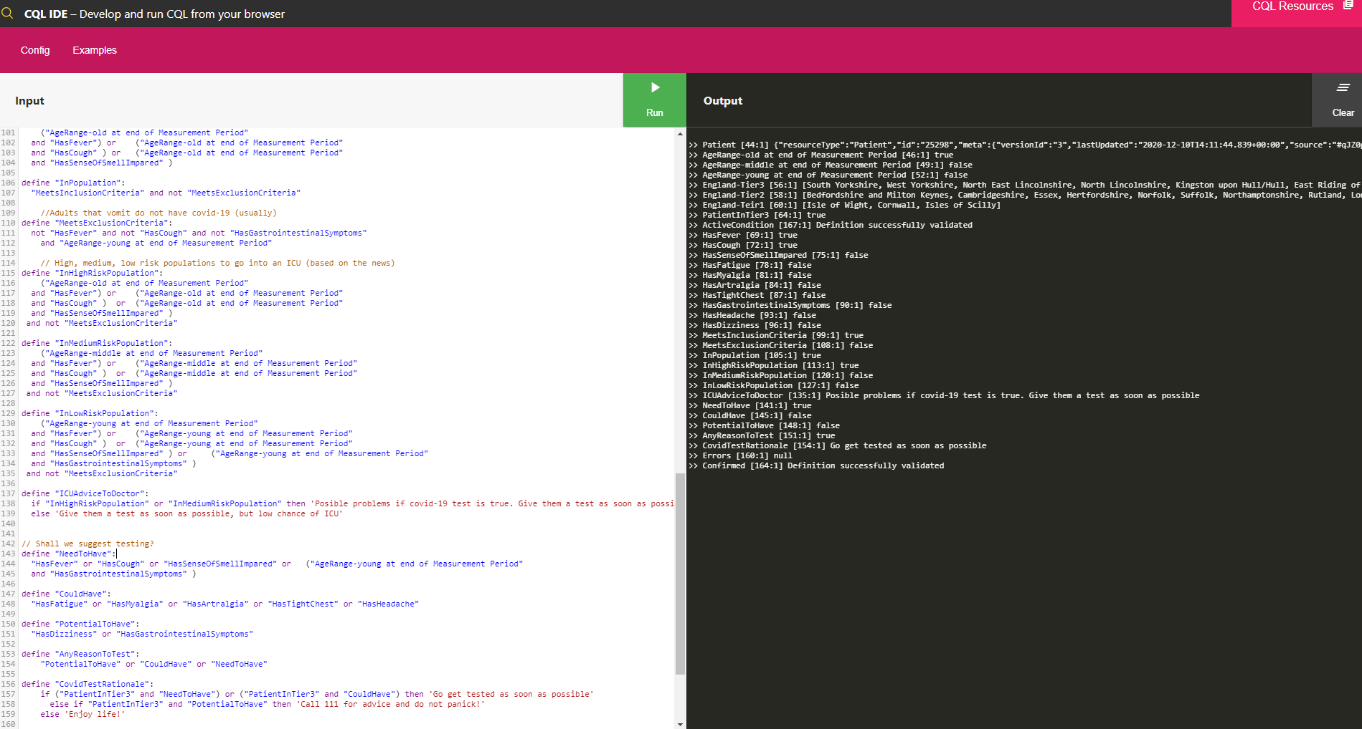
Test case
200 lines of code
21 SNOMED codes and 20 ICD-10 codes

Slide 4
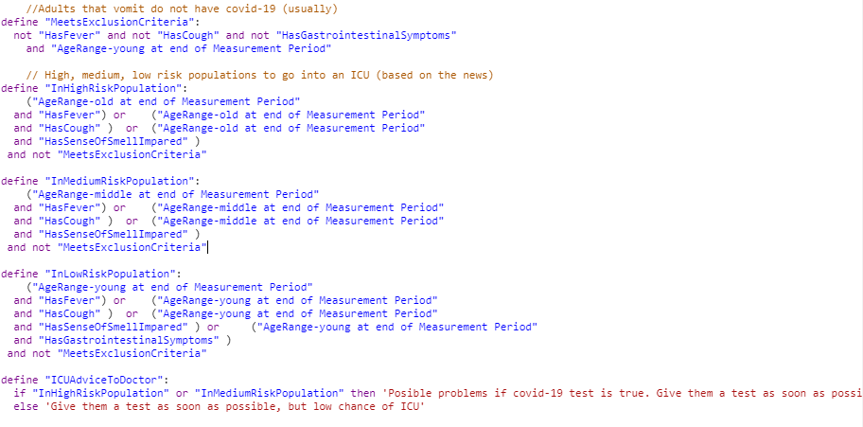

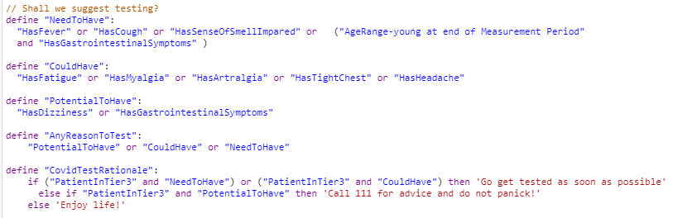

Results
Snippets

Slide 5

Sometimes the suggested symptoms are quite vague, requiring research into whether it’s a presence of absence of a symptom.
The novice programmer would have problems nesting queries.
Need more explicit guidelines in terms of what is measured first, second etc.
Need for reusable libraries - CQL, FIHR
IDE slow the more you define functions.
Need a YouTube video to connect to FIHR.
The novice programmer would have problems nesting queries.
Finding relevant information and lesson learned

Slide 6

Challenges
Need clinician input for this, which is time consuming.
May be different definitions for clinically relevant diagnoses and research relevant diagnoses
Diagnosing COVID-19

Slide 7
Challenges
NHS has been known to use previous versions of code systems, which aren’t necessarily the most up to date version.
This can cause compatibility issues when looking for codes
Standardising code systems used
Potentially pose issues with worldwide examination of hospital data

Slide 8

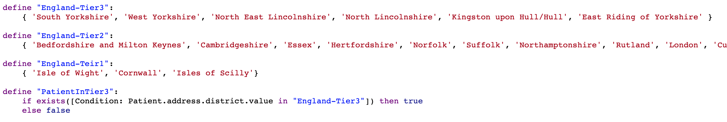
Novelty & Creativity
Extensions to BMJ COVID-19 Definition
Prof. Neil Sebire - If you vomit and an adult, low risk
Anne Marie - Use postalCode and combine with Tier levels (England)

Slide 9
Much TODO about nothing...
Gender
Taking gender into account
Ethnicity
Taking BAME ethnicity into account for risk stratification
Symptom Severity
Taking severity of symptoms into account (e.g. Fever, Cough, etc)
Reuse/Implement external algorithms
QCOVID Algorithm in CQL
Develop reusable functions/libraries
Create a reusable video tutorials and FIHR/CQL 101 materials

Slide 10

Team Photo

